Slide 1

Social Media Marketing
Gabby Gaspard
COMM 4350

Slide 2

Should companies be using social media to market and advertise?

Slide 3
Almost everyone uses social media now.

Slide 4
“Over the past year, more than half of consumers (54%) say their use of social media has grown” (Drenik, 2021)

Slide 5
Social media allows people to discover new products and companies.

Slide 6
It is free to use. Companies don’t have to pay social network sites to post things.

Slide 7
Social media allows brnads to connect with their costumers on a more personal level.

Slide 8
Social media marketing is very effective. Companies should be using it as a marketing tool.

Slide 9
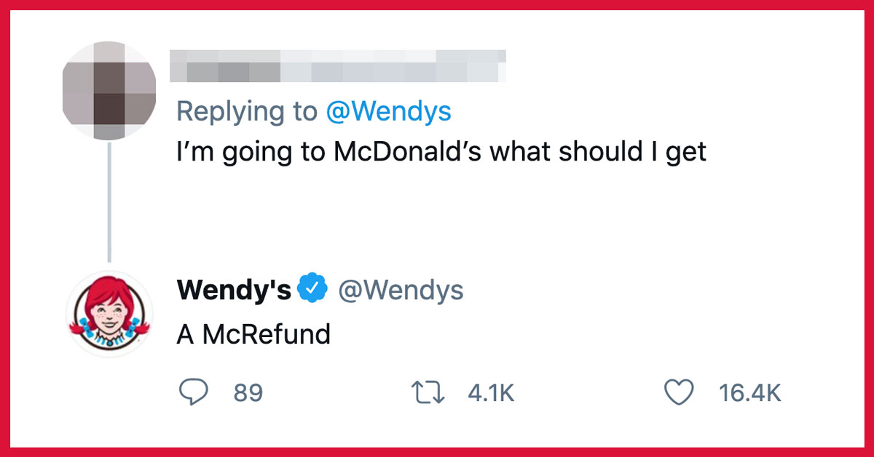
Wendy’s Twitter

Slide 10
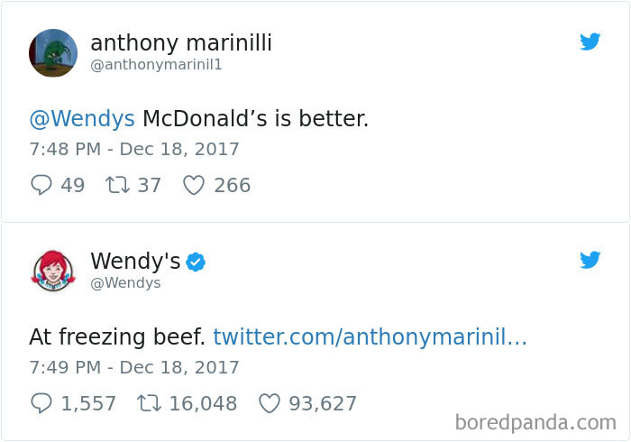
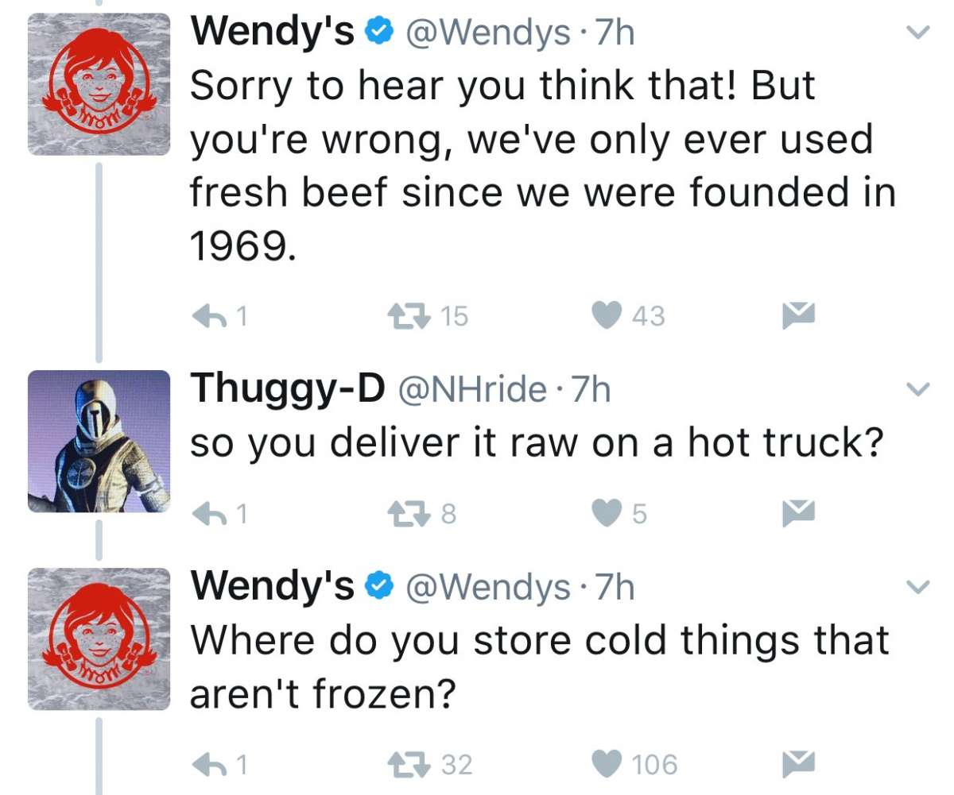

Slide 11
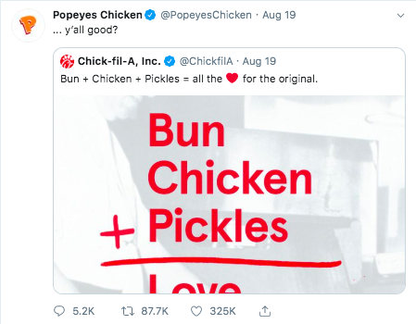
Popeye’s Chicken Sandwich

Slide 12
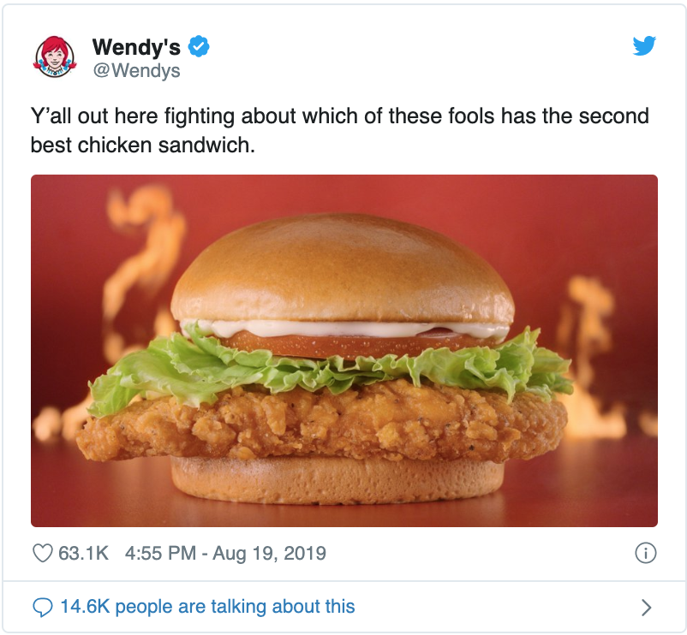

Slide 13
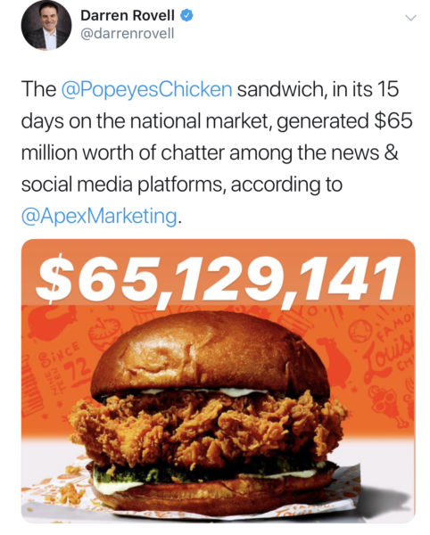

Slide 14
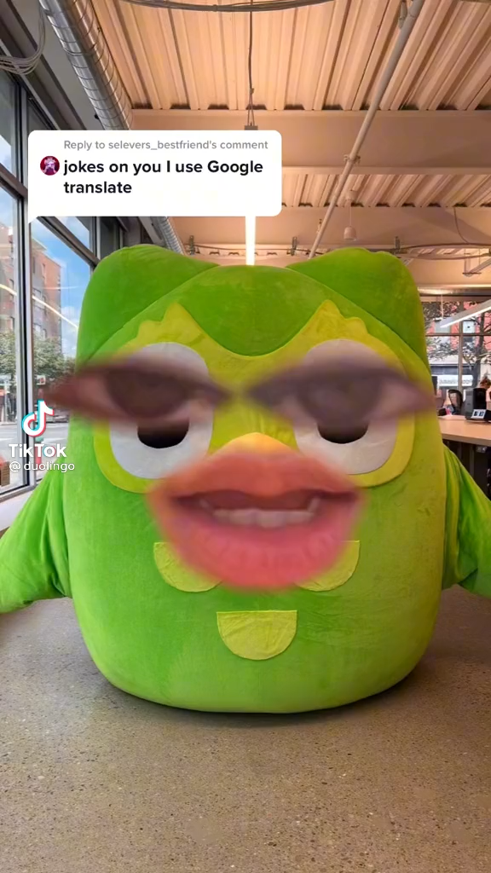
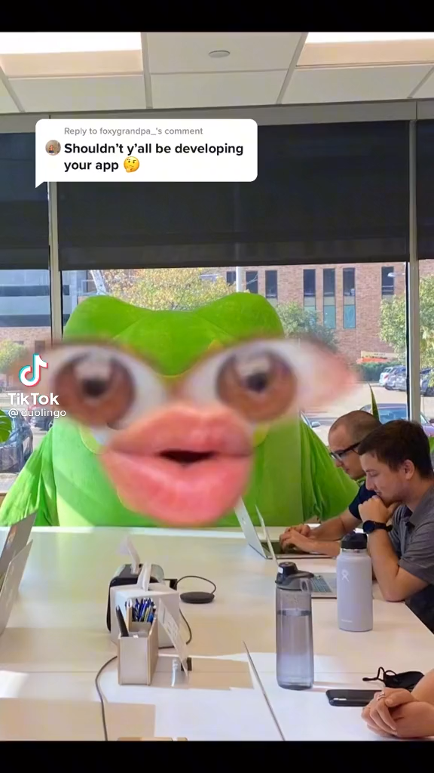
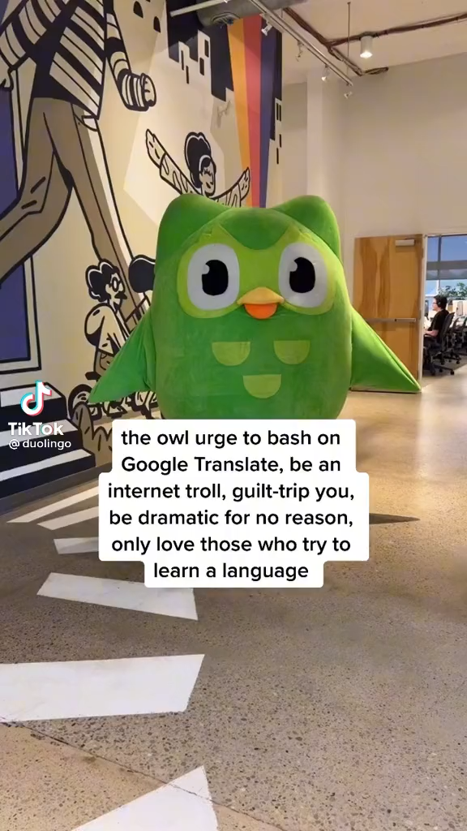
Duolingo TikToks

Slide 15
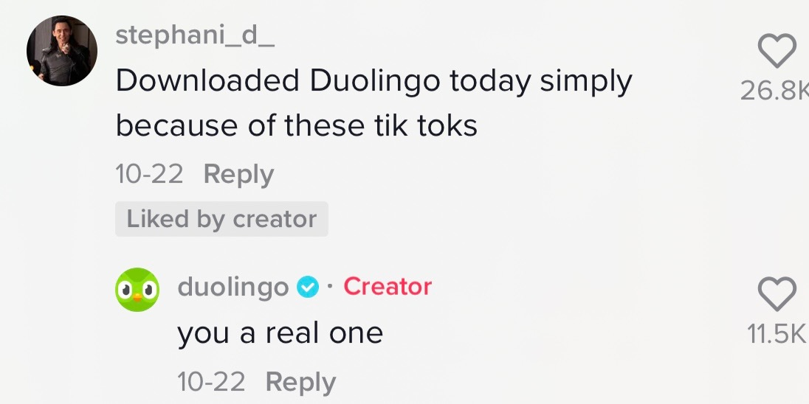
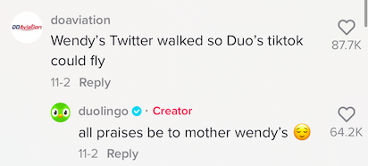
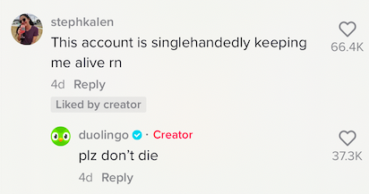
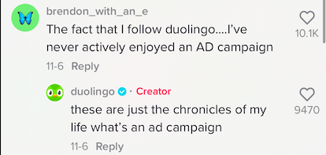

Slide 16
How to use social media effectively
1. Post consistently
2. Have fun with it
3. Know your audience
4. Create an image

